Slide 1

Go, change the world
RV College of
Engineering
Unit -1
Introduction to Programming

Slide 2

Go, change the world
RV College of
Engineering
Contents
Definition of a computer.
Components of computer system,
Programming Languages.
Design and implementation of efficient programs.
Program Design Tools: Algorithms,
Flowcharts and Pseudocodes.
Types of Errors

Slide 3

Go, change the world
RV College of
Engineering
1. Definition of a computer:
A computer, in simple terms, can be defined as
“an electronic device that is designed to accept data, perform the required mathematical and logical operations, and produces reliable and expected result(output)”.

Slide 4
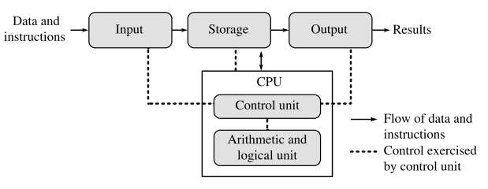
Go, change the world
Basic Computer Organization
RV College of
Engineering
A computer basically performs five major operations:
    Accepting data or instructions (input) : keyboard, mouse, scanner, trackball
    Storing data: Primary(RAM) and secondary memory(Disk Drives)
    Processing data: Control Unit(CU) and Arithmetic and Logic Unit(ALU)
    Displaying results (output): Monitor, printer, speakers etc.,
    Controlling and coordinating all above operations inside a computer

Slide 5
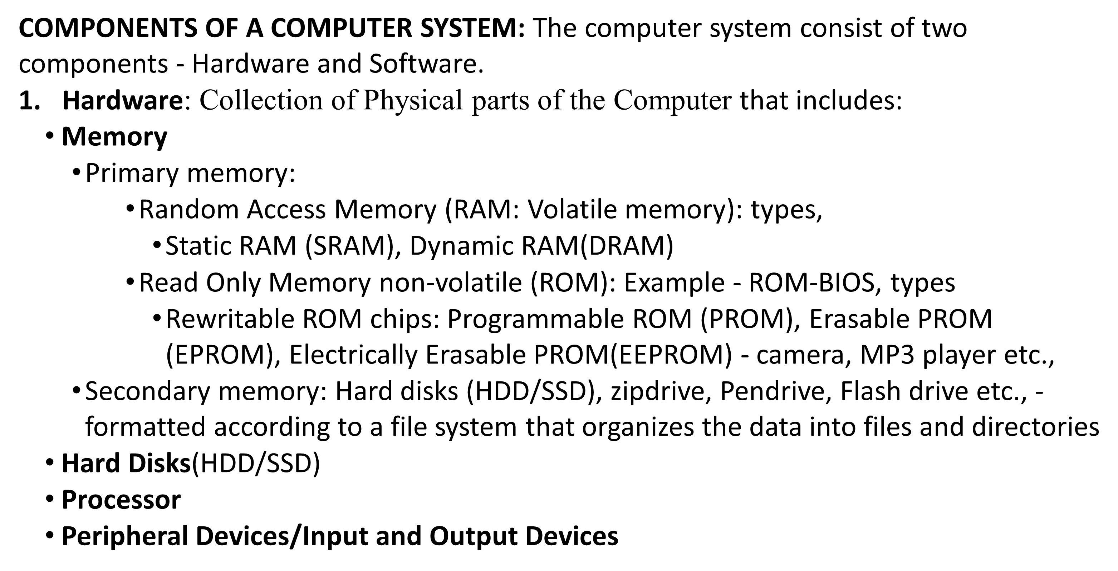
Go, change the world
RV College of
Engineering
RAM is essential for the smooth operation of computers and devices, providing temporary storage that enhances speed, supports multitasking, and facilitates real-time processing

Slide 6
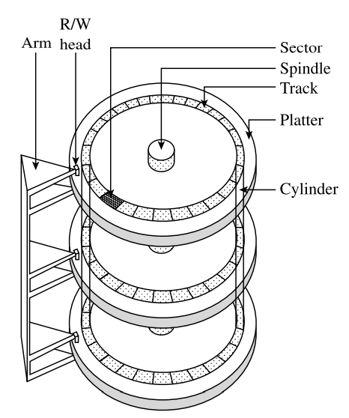
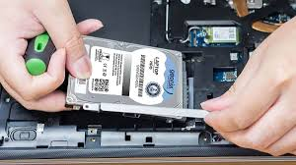
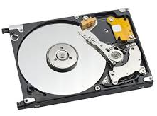
Go, change the world
RV College of
Engineering
Hard Disks
A hard disk is a set of disks(platters), stacked together like phonograph records, and each disk has data recorded electromagnetically in concentric circles known as tracks.
Each platter requires two read/write (R/W) heads, one for each side.
The R/W head move back and forth over the platters to read or write data
Data is actually stored on the surface of a platter in tracks and sectors.

Slide 7
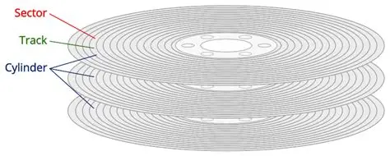
Go, change the world
RV College of
Engineering
The performance of a hard disk depends on its access time. Access time is a combination of the following:
Seek time: time taken to position the R/W head over the appropriate cylinder (~8 ms).
Rotational delay: time taken to bring the target sector to rotate under the R/W head.
Transfer time: time to transfer data from sector
Access time = seek time + rotational delay + transfer time.
Disk latency: time taken to initiate a transfer (seek time + rotational delay)

Slide 8
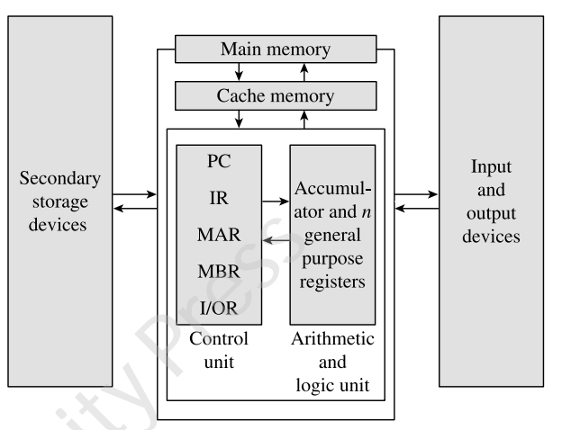
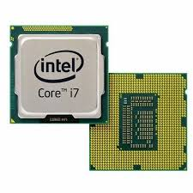
Go, change the world
RV College of
Engineering
Processor
A basic processor consists of two main parts - Execution Unit, and a Bus Interface Unit (BIU).
Execution unit The execution unit mainly consists of the CU, ALU, and registers

Slide 9
Go, change the world
RV College of
Engineering
Control Unit (CU) - Main functions are,
guide and coordinate the computer operations.
interprets the instructions (program) and initiates action to execute them.
controls the flow of data through the computer system and directs (how they have to function) the ALU, registers, buses, and input/output (I/O) devices.
Responsible for CPU Cycle (data fetching, encoding, and processing) and storing the results.
Arithmetic and logic unit:
The ALU performs arithmetic (add, subtract, multiply, divide, etc.), comparison (less than, greater than, or equal to), and other operations.
-

Slide 10
Go, change the world
RV College of
Engineering
Register(s): is ultrafast computer memory that provides quick access to the data currently being used by ALU for processing and storing result.
Types of registers, each with a specific storage function:
  Accumulator and general-purpose registers: to store the data brought from the main memory (RAM) and the intermediate results from ALU
  Special purpose registers – Memory Address Register (MAR), Memory Buffer Register (MBR), Instruction Register (IR), I/O register and Program Counter (PC)

Slide 11
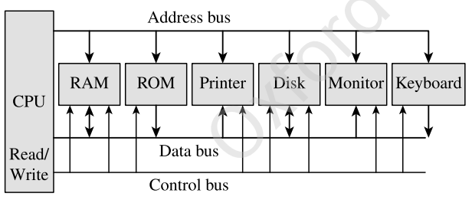
Go, change the world
RV College of
Engineering
Bus Interface Unit: provide functions for transferring data between the execution unit of the CPU and other components of the computer system that lie outside the CPU.
There are three different types of busses - data bus, control bus, and address bus
The BIU puts the contents of the program counter on the address bus.
Once the memory receives an address from the BIU, it places the contents at that address on the data bus, which is then transferred to the IR of the processor through the MBR.
At this time, the contents of the program counter are modified (e.g., incremented by 1) so that it now stores the address of the next instruction

Slide 12
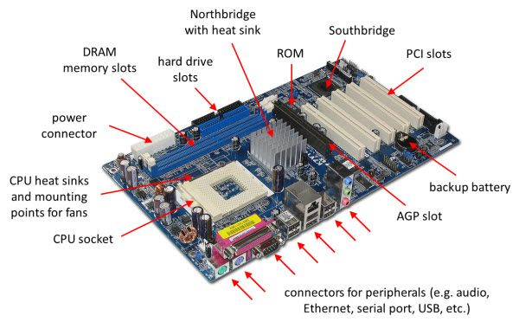
(Peripheral Component Interconnect Slot)
(Accelerated Graphics Port)

Slide 13
Go, change the world
RV College of
Engineering
Instruction set The instruction set is a set of commands that instructs the processor to perform specific tasks
System clock A small quartz crystal circuit, that controls the timing of all operations within the computer system
Processor speed is specified in MHz or GHz varies from type of computers
Pipelining and parallel processing is a technique with which the processor can fetch the second instruction before completing the execution of the first instruction. (superscalar processors)

Slide 14
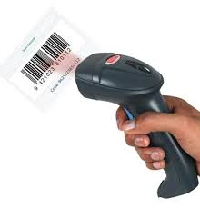
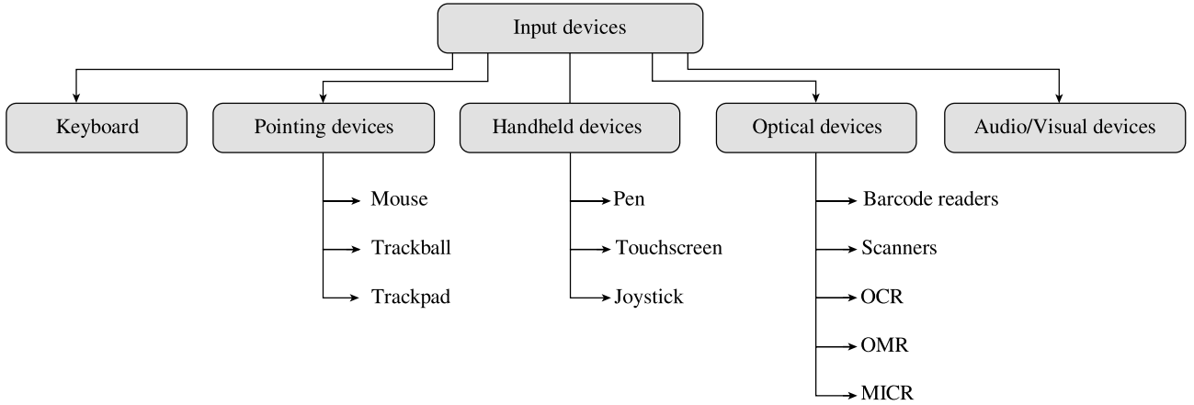

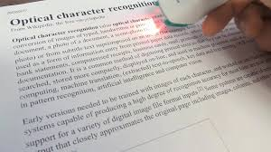

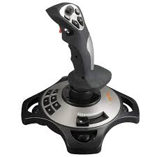
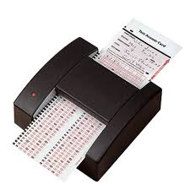
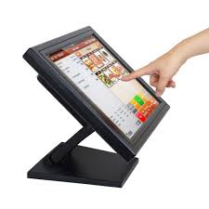
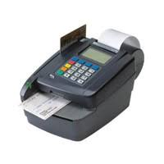
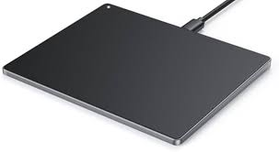
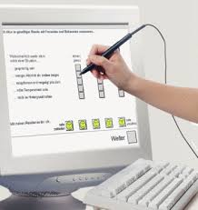
Go, change the world
RV College of
Engineering
Peripheral Devices/Input and Output Devices
We need input and output devices for computers to be able to interact with its users
There are different types of input/output devices,

Slide 15
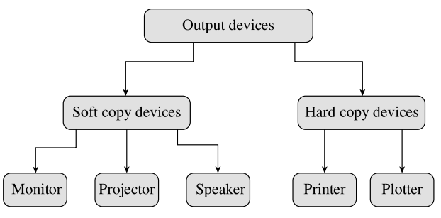
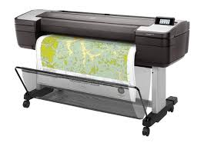
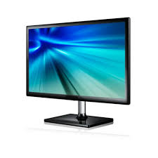
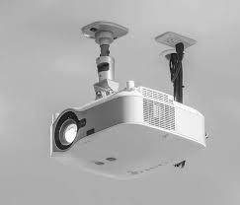
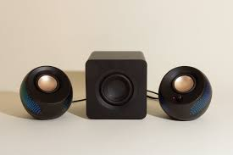
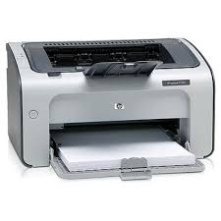
Go, change the world
RV College of
Engineering
Input Devices - An input device is used to feed data and instructions into the computer.
Output Devices - Any device that receives and display an information obtained after data processing by CPU is called as an output device.

Slide 16
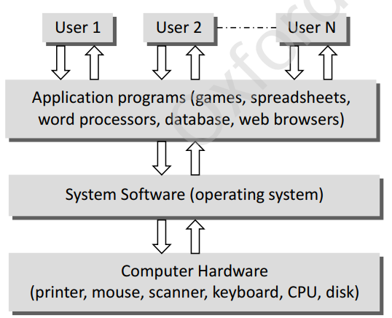
Go, change the world
RV College of
Engineering
2. Computer Software: Computer software can be broadly classified into two groups: system software and application software.
System software : provides a general programming environment in which programmers can create specific applications to suit their needs. This environment provides new functions that are not available at the hardware level and performs tasks related to execution of application programs.
Application software is designed to solve a particular problem for users.
Simply put application software represents programs that allow users to do something besides simply running the hardware

Slide 17
Go, change the world
RV College of
Engineering
System Software :
System software is software designed to operate the computer hardware and to provide and maintain a platform for running application software.
The most widely used system software are:
Computer BIOS and Device Drivers : BIOS is stored on a ROM chip built into the system. The key role of BIOS is to load and start the operating system. the code in the BIOS chip runs a series of tests called POST (Power On Self Test) to ensure that the system devices are working correctly. BIOS then locates software held on a peripheral device such as a hard disk or a CD, and loads and executes that software, giving it control of the computer. This process is known as booting

Slide 18
Go, change the world
RV College of
Engineering
To summarize, BIOS performs the following functions:
Initializes the system hardware
Initializes system registers
Initializes power management system
Tests RAM
Tests all the serial and parallel ports
Initializes CD/DVD drive and hard disk controllers
Displays system summary information

Slide 19
Go, change the world
RV College of
Engineering
2. Operating System:
The primary goal of an operating system is to make the computer system (or any other device in which it is installed like a cell phone) convenient and efficient to use.
An operating system offers generic services to support user applications.
An operating system ensures that the system resources (such as CPU, memory, I/O devices) are utilized efficiently
it is important for an operating system to have a control policy and algorithm to allocate the system resources.

Slide 20
Go, change the world
RV College of
Engineering
3.Utility Software:
Utility software is used to analyse, configure, optimize, and maintain the computer system.
Utility programs may be requested by application programs during their execution for multiple purposes.
Some of them are as follows:
Disk defragmenters, Disk checkers, Disk cleaners, Disk space analysers, Disk partitions utilities, Backup utilities, Disk compression utilities, File managers, System profilers, Anti-virus utilities , Data compression utilities, Cryptographic utilities, Launcher applications, Registry cleaners, Network utilities, Command line interface (CLI) and Graphical user interface (GUI)3.

Slide 21
Go, change the world
RV College of
Engineering
4. Compiler, Interpreter, Linker, and Loader
Compiler: It is a special type of program that transforms the source code written in a programming language (the source language) into machine language comprising just two digits, 1s and 0s (the target language). The resultant code in 1s and 0s is known as the object code. The object code is the one which will be used to create an executable program.
Interpreter: The interpreter, on the other hand, translates the instructions into an intermediate form, which it then executes. interpreter interprets the source code line by line
Linker(link editor binder) It is a program that combines object modules to form an executable program. The compiler automatically invokes the linker as the last step in compiling a program, to put together all the submodules object codes together.
Loader It is a special type of program that copies programs from a storage device to main memory, where they can be executed.

Slide 22
Go, change the world
RV College of
Engineering
Application Software:
Application software is a type of computer software that employs the capabilities of a computer directly to perform a user-defined task.
Typical examples of software applications are word processors, spreadsheets, media players, education software, CAD, CAM, data communication software, and statistical and operational research software

Slide 23
Go, change the world
RV College of
Engineering
PROGRAMMING LANGUAGES
A programming language is a language specifically designed to express computations that can be performed by the computer.
Programming languages are used to create programs that control the behaviour of a system, to express algorithms, or as a mode of human–computer communication.
programming languages have a vocabulary of syntax and semantics for instructing a computer to perform specific tasks.
The term programming language usually refers to high-level languages, such as BASIC, C, C++, COBOL, FORTRAN

Slide 24
Go, change the world
RV College of
Engineering
While high-level programming languages are easy for humans to read and understand, the computer actually understands the machine language that consists of numbers only.
Each type of CPU has its own unique machine language
In between the machine languages and high-level languages, there is another type of language known as assembly language.
Assembly languages are similar to machine languages, but they are much easier to program because they allow a programmer to substitute names for numbers.
There are two ways to convert the program written using any programming language into machine language is: compile the program or interpret the program

Slide 25
Go, change the world
RV College of
Engineering
The question of which language is the best depends on the following factors:
The type of computer on which the program has to be executed
The type of program
The expertise of the programmer

Slide 26
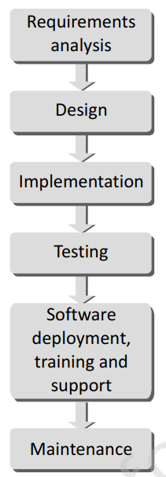
Go, change the world
RV College of
Engineering
DESIGN AND IMPLEMENTATION OF EFFICIENT PROGRAMS
The entire program or software (collection of programs) development process is divided into a number of phases where each phase performs a well-defined task. Moreover, the output of one phase provides the input for its subsequent phase.
Requirements Analysis: All the gathered users’ requirements are analysed to pen down the scope or the objective of the overall software product. Documenting every identified requirement of the users in order to avoid any doubts or uncertainty regarding the functionality of the programs. The functionality, capability, performance, availability of hardware and software components are all analysed in this phase

Slide 27
Go, change the world
RV College of
Engineering
Design:
A plan of actions is made before the actual development process could start.
This plan will be followed throughout the development process.
In the design phase the core structure of the software/program is broken down into modules.
The solution of the program is then specified for each module in the form of algorithms, flowcharts, or pseudocodes.
The design phase, therefore, specifies how the program/software will be built.

Slide 28
Go, change the world
RV College of
Engineering
Implementation:
The designed algorithms are converted into program code using any of the high level languages.
The particular choice of language will depend on the type of program like whether it is a system or an application program.
The program codes are tested by the programmer to ensure their correctness. This phase is also called construction or code generation phase as the code of the software is generated in this phase.
While constructing the code, the development team checks whether the software is compatible with the available hardware and other software components that were mentioned in the Requirements Specification Document created in the first phase.
Testing
In this phase, all the modules are tested together to ensure that the overall system works well as a whole product.
Integration testing is done in this phase.
Testing is done to ensure that the software is working as expected by the users’ requirements that were identified in the requirements analysis phase.

Slide 29
Go, change the world
RV College of
Engineering
Software Deployment, Training, and Support
After the code is tested and the software or the program has been approved by the users, it is then installed or deployed in the production environment.
Software Training and Support is a crucial phase which is often ignored by most of the developers to use and fix up small errors
Maintenance
Maintenance and enhancements are ongoing activities which are done to cope with newly discovered problems or new requirements.
Such activities may take a long time to complete as the requirement may call for addition of new code that does not fit the original design or an extra piece of code required to fix an unforeseen problem.
As a general rule, if the cost of the maintenance phase exceeds 25% of the prior-phases cost then it clearly indicates that the overall quality of at least one prior phase is poor.
In such cases, it is better to re-build the software (or some modules) before maintenance cost is out of control.

Slide 30
Go, change the world
RV College of
Engineering
PROGRAM DESIGN TOOLS: ALGORITHMS, FLOWCHARTS, PSEUDOCODES
1 Algorithms: In programming, algorithm is a set of well-defined instructions in sequence to solve the problem and it provides a blueprint to write a program to solve a given problem.
Algorithms are mainly used to,
- achieve software reuse.
reimplement in any high-level language, such as C, C++, Java, and so on
In order to qualify as an algorithm, it should
Be precise
Be unambiguous
Not even a single instruction must be repeated infinitely
After the algorithm gets terminated, the desired result must be obtained

Slide 31
Go, change the world
RV College of
Engineering
Control Structures used in Algorithms
Broadly speaking, an algorithm can employ any of the three control structures, namely,
Sequence: Sequence means that each step of the algorithm is executed in the specified order
Decision: Decision statements are used when the outcome of the process depends on some condition.
Repetition: which involves executing one or more steps for a number of times, can be implemented using constructs such as while, do-while, and for loops.

Slide 32
Go, change the world
RV College of
Engineering
Selecting the Most Efficient Algorithm Many a times, you may formulate more than one algorithm for a problem. In such cases, you must always analyze all the alternatives and try to choose the most efficient algorithm. This can be done by analyzing time and space complexity of the algorithms designed.
The time complexity of an algorithm is basically the running time of a program as a function of the input size. Similarly, the space complexity of an algorithm is the amount of computer memory that is required during the program execution as a function of the input size.

Slide 33
Go, change the world
RV College of
Engineering
2 Flowcharts
A flowchart is a graphical or symbolic representation of a process.
It is basically used to design and document virtually complex processes to help the viewers to visualize the logic of the process, so that they can gain a better understanding of the process.
When designing a flowchart, each step in the process is depicted by a different symbol and is associated with a short description.
The symbols in the flowchart are linked together with arrows to show the flow of logic in the process.

Slide 34
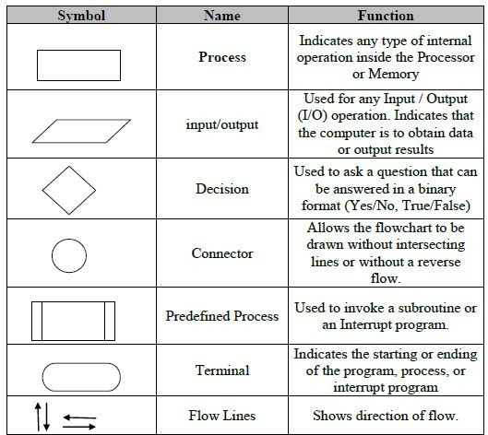

Slide 35
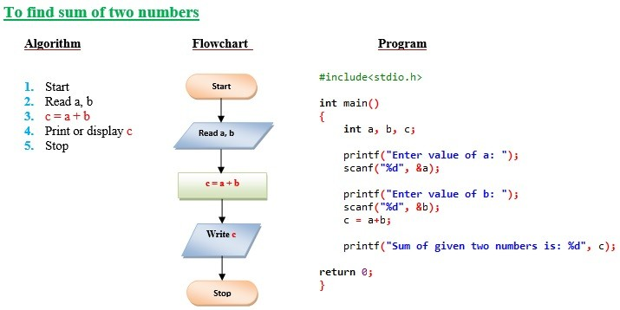
Example
RV College of Engineering
Go, change the world

Slide 36
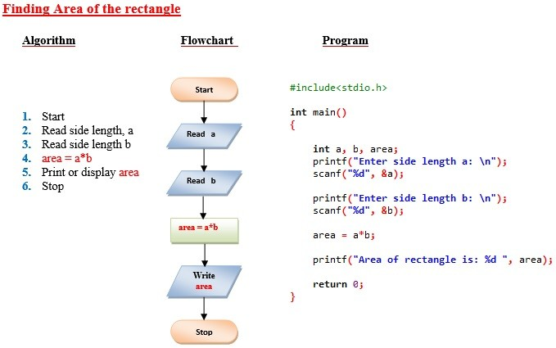
Example
RV College of Engineering
Go, change the world

Slide 37
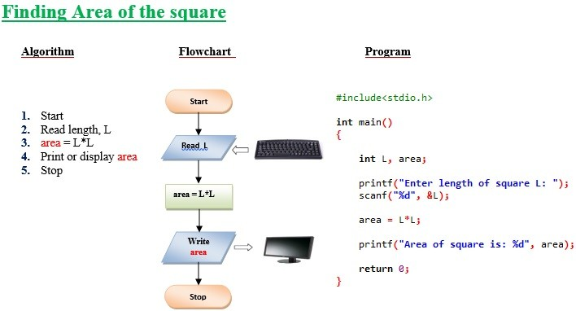
Example
RV College of Engineering
Go, change the world

Slide 38
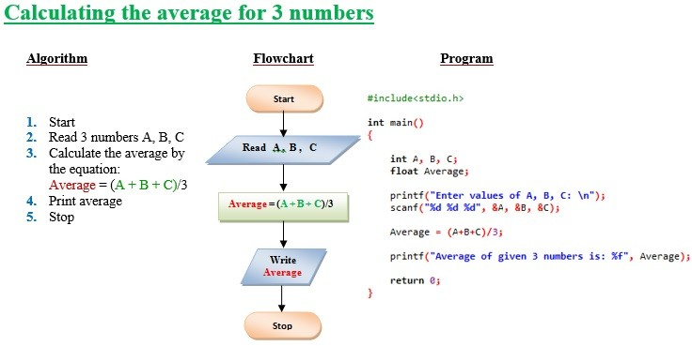
Example
RV College of Engineering
Go, change the world

Slide 39
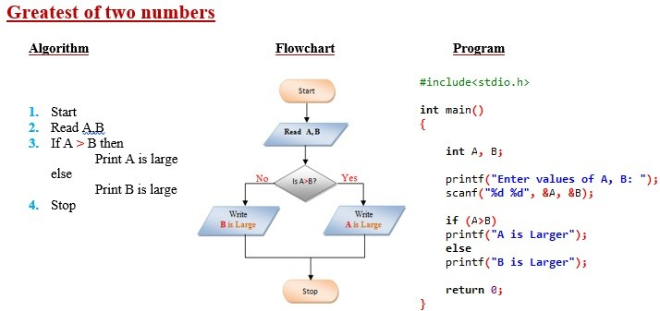
Example
RV College of Engineering
Go, change the world

Slide 40
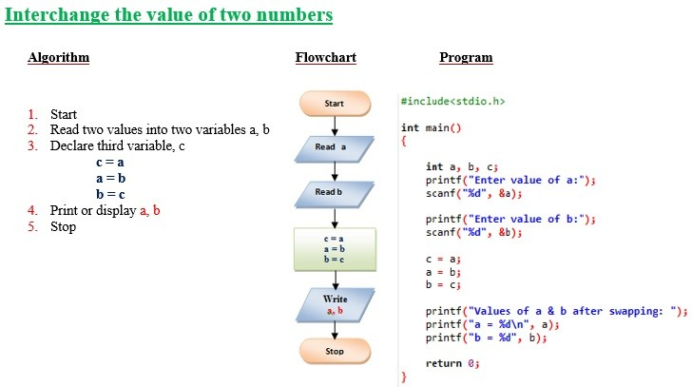
Example
RV College of Engineering
Go, change the world

Slide 41
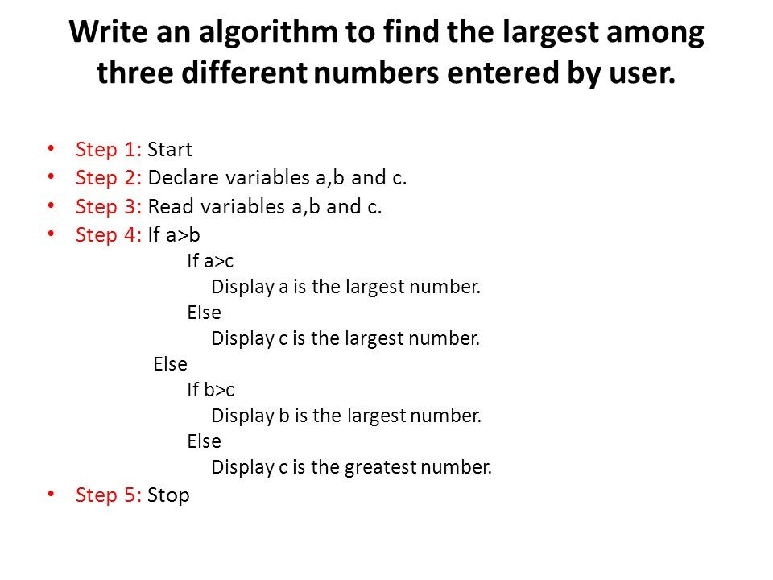
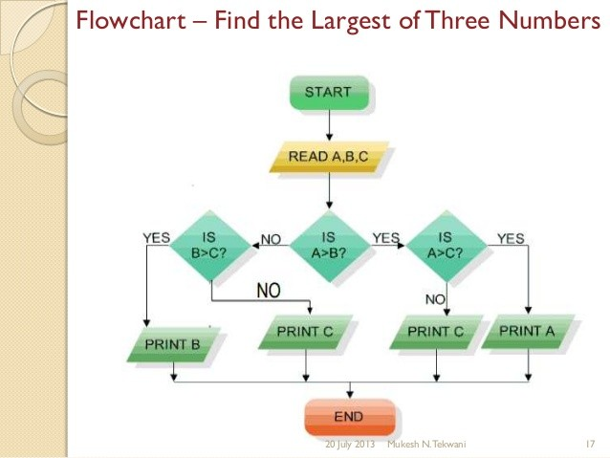
Example
RV College of Engineering
Go, change the world

Slide 42
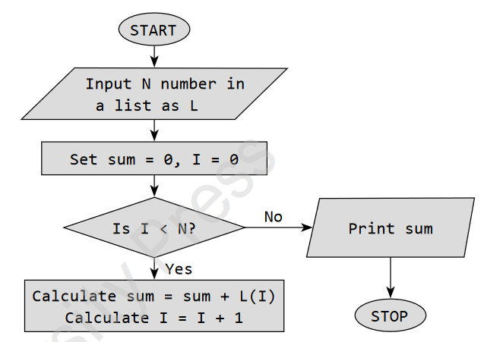
Sum of array of numbers
Step 1: Start
Step 2: Read a list of N numbers from the user as L
Step 3: Set sum = 0, I = 0
Step 4: WHILE I < N
Calculate sum = sum + L[I]
Calculate I = I + 1
Step 5: Print sum
Step 6: End

Slide 43
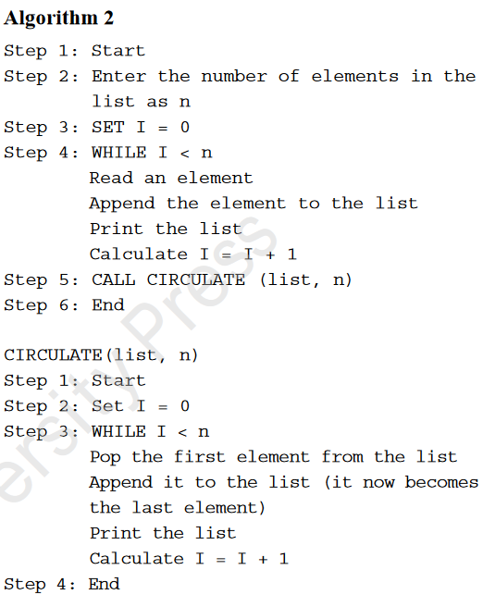

Slide 44
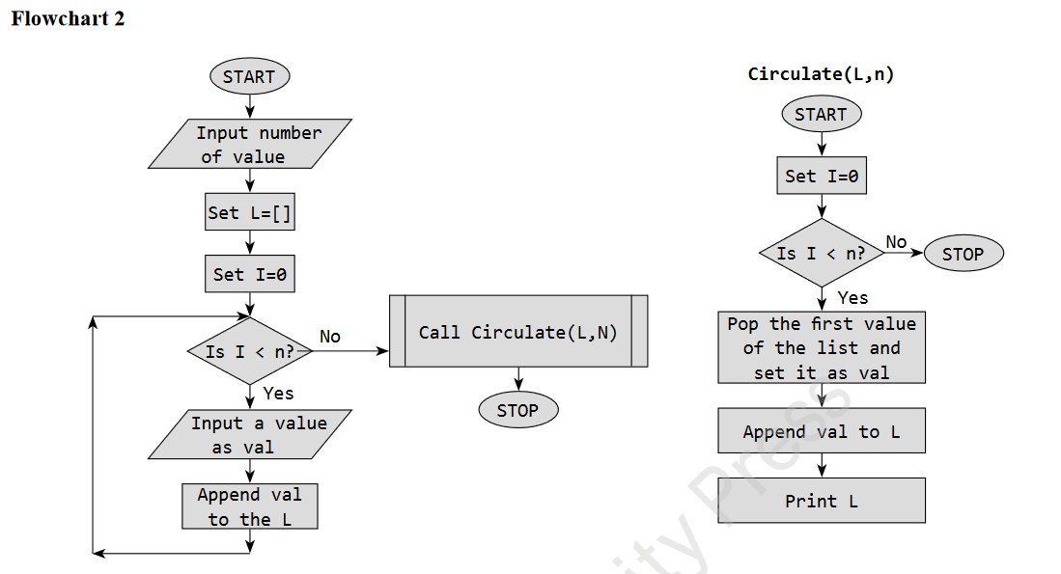

Slide 45
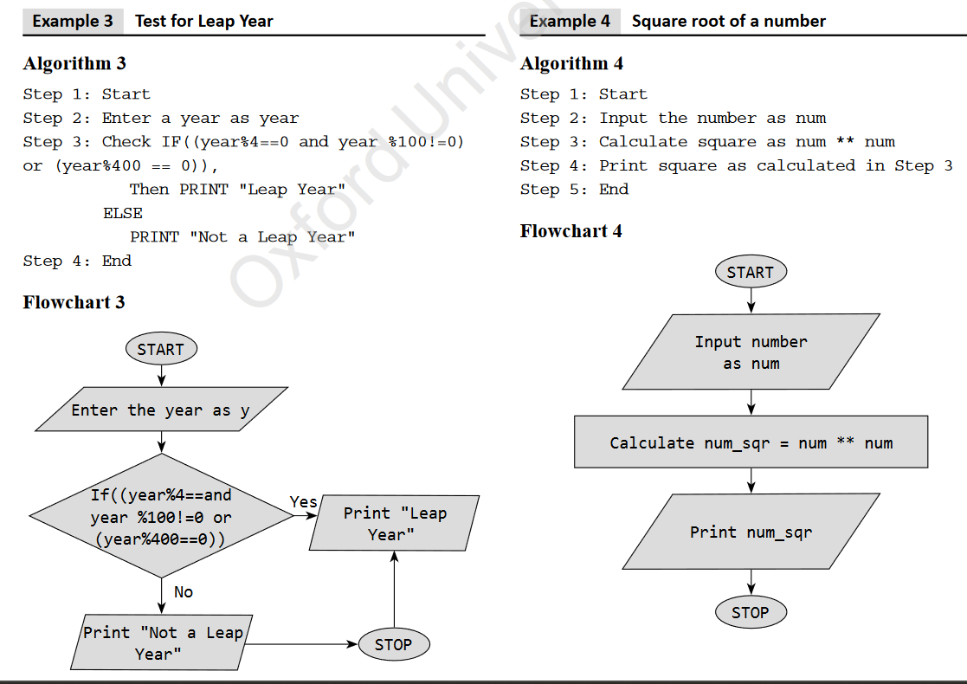

Slide 46
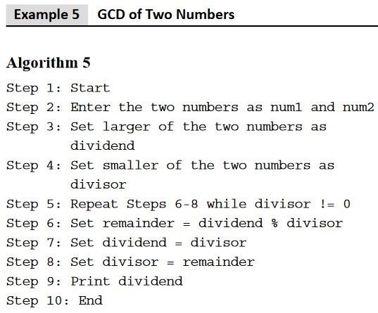
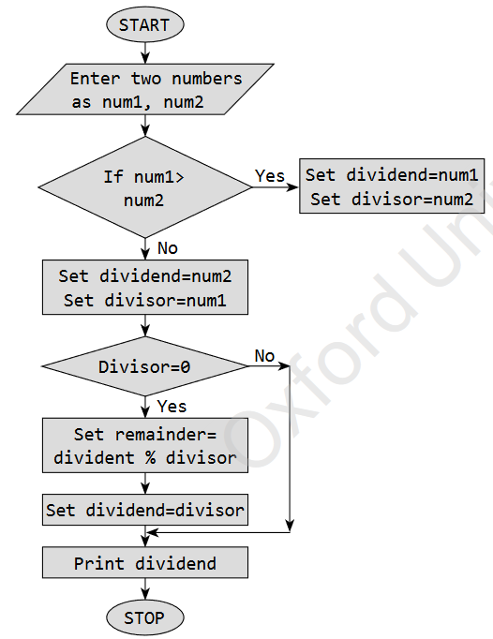

Slide 47
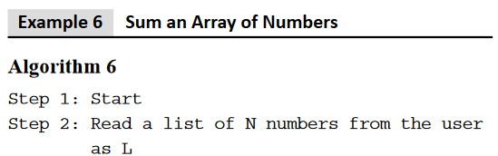
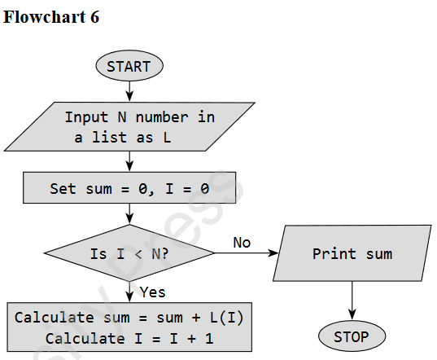
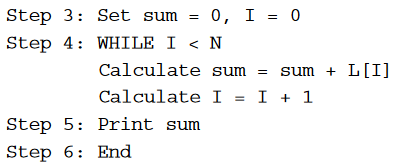

Slide 48
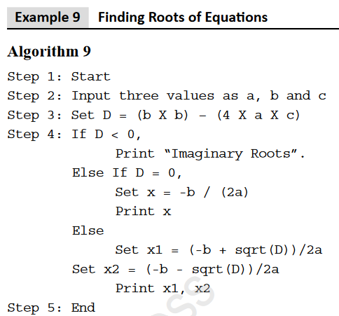
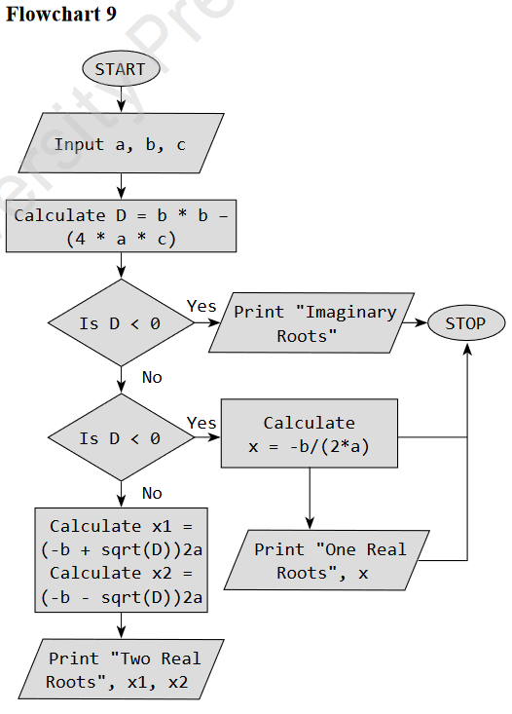

Slide 49
Go, change the world
RV College of
Engineering
3 Pseudocodes
Pseudocode is a compact and informal high-level description of an algorithm that uses the structural conventions of a programming language.
Pseudocodes are an outline of a program that can be easily converted into programming statements.
They consist of short English phrases that explain specific tasks within a program’s algorithm. They should not include keywords in any specific computer language.
The sole purpose of pseudocodes is to enhance human understandability of the solution.
They are commonly used in textbooks and scientific publications for documenting algorithms, and for sketching out the program structure before the actual coding is done
There are no standards defined for writing a pseudocode, because a pseudocode is not an executable program.

Slide 50
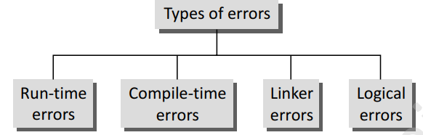
Go, change the world
RV College of
Engineering
TYPES OF ERRORS:
While writing programs, very often we get errors in our program. These errors if not removed will either give erroneous output or will not let the compiler to compile the program.
These errors are broadly classified under four groups:

Slide 51
Go, change the world
RV College of
Engineering
Run-time Errors
As the name suggests, run-time errors occur when the program is being run executed. Such errors occur when the program performs some illegal operations like
        Dividing a number by zero
        Opening a file that already exists
        Lack of free memory space
        Finding square or logarithm of negative numbers

Slide 52
Go, change the world
RV College of
Engineering
Compile-time Errors
Again as the name implies, compile errors occur at the time of compilation of the program.
Such errors can be further classified as follows:
    Syntax Errors:Syntax error is generated when rules of C programming language are violated.
    Semantic Errors: Semantic errors are those errors which may comply with rules of the programming language but are not meaningful to the compiler
    Logical Errors: Logical errors are errors in the program code that result in unexpected and undesirable output which is obviously not correct.
    Linker Errors: These errors occur when the linker is not able to find the function definition for a given prototype.

Slide 53

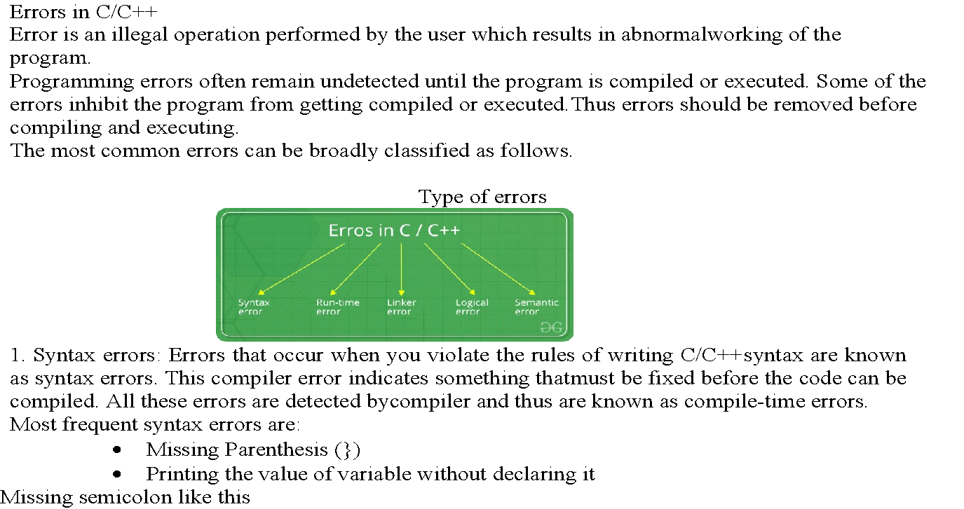
Types of Errors continued….
RV College of Engineering
Go, change the world

Slide 54
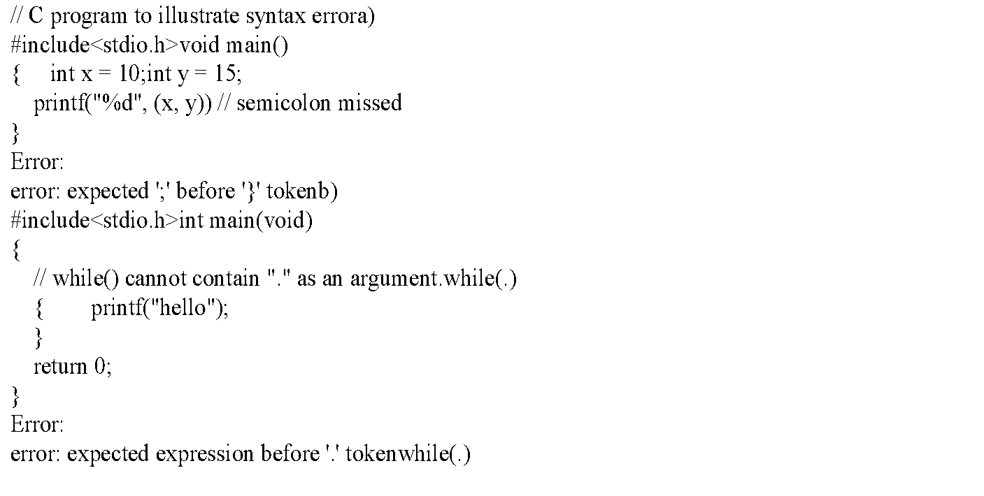
Types of Errors
RV College of Engineering
Go, change the world

Slide 55

Types of Errors
RV College of Engineering
Go, change the world

Slide 56

Types of Errors
RV College of Engineering
Go, change the world

